Slide 1

Inclusive Excellence

Slide 2
Session Goals
Understand Inclusive Excellence
Understand ASU Charter and Statement of Inclusion
FSE Expectations

Slide 3
Inclusive Excellence
Think, Pair, Share
Inclusive excellence at Arizona State University is a commitment to all ethnic, intellectual, socioeconomic and cultural backgrounds; accounting for the deepest possible grasp of diverse perspectives and identities; and building upon our promise to measure ourselves by whom we include and how they succeed. Under the guidance of the provost, a dedicated team stewards this commitment through collaborative work within a dynamic enterprise-wide ecosystem focused on diversity, equity and inclusion.
Notes:
https://inclusion.asu.edu/about

Slide 4
Inclusive Excellence
Think, Pair, Share
Inclusive excellence at Arizona State University is a commitment to all ethnic, intellectual, socioeconomic and cultural backgrounds; accounting for the deepest possible grasp of diverse perspectives and identities; and building upon our promise to measure ourselves by whom we include and how they succeed. Under the guidance of the provost, a dedicated team stewards this commitment through collaborative work within a dynamic enterprise-wide ecosystem focused on diversity, equity and inclusion.
Notes:
https://inclusion.asu.edu/about

Slide 5
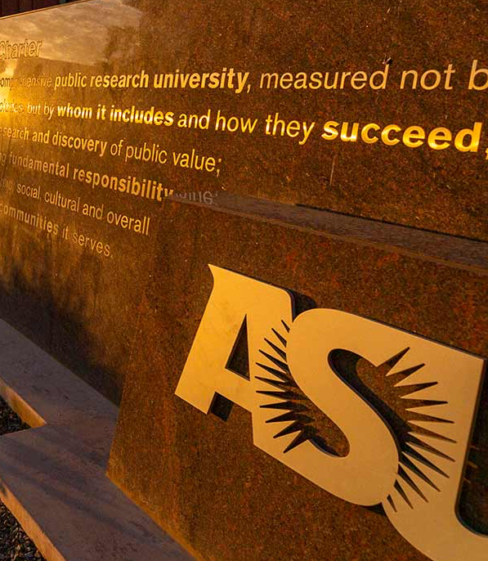
What stands out to you about the ASU charter?
What do you agree with the most?
How might you personally connect to the charter?
ASU Charter
ASU is a comprehensive public research university, measured not by whom it excludes, but by whom it includes and how they succeed; advancing research and discovery of public value; and assuming fundamental responsibility for the economic, social, cultural and overall health of the communities it serves.
https://newamericanuniversity.asu.edu/about/asu-charter-mission-and-goals
Notes:
The diversity among our student body is one of our strengths; if we want an inclusive university, then it would follow that it is the students that need to be inclusive. -- “If we want ASU to be a certain way, then we need to be that way”.

Slide 6
Inclusion at ASU
How do you see ASU supporting you and your classmates?
What do you expect from the university? Why?
If you were in charge, what would you do?
How can we make sure everyone feels included, respected, safe, and supported at ASU?
How can we create a healthy and inclusive community?
Notes:
Discussion questions:•How we create a healthy and inclusive community?•how do we make sure everyone feels included, respected, safe, and supported at ASU?•Sun Devils build a community of care together, and it takes action from every community member in order to create an environment where all students feel included, respected, safe, and supported. • Please break into groups of 3-4 students and create a definition of a healthy and inclusive community. Summarize this with 3-4 characteristics of a health and inclusive community that you all agree on. (2 minutes)• Go around the room and build your classroom definition of a healthy and inclusive community. (2 minutes)VERY IMPORTANT: IF SOMEONE DOES NOT SAY A HEALTHY AND INCLUSIVE COMMUNITY IS A PLACE WHERE PEOPLE LOOK OUT FOR EACH OTHER, ADD IT TO THE LIST

Slide 7
Fulton Expectations Underpin a diverse and inclusive learning community
Professionalism
Academic Integrity
Notes:
Before we begin, let’s have a review of the Fulton Expectations that we learned about, and talk briefly about how they contribute to a diverse and inclusive community.
Do you remember reading the professionalism expectation? What were some of the key points?
I am an integral part of a vibrant learning community.
I pledge to uphold the highest standards
I will remember that we are all part of a shared learning community
I will always strive to listen to feedback with an open mind
What else?
Do you think professionalism is important when talking about diversity and inclusion? Why/Why not?
Both Professionalism and Academic Integrity are underpinned by three important FSE ideals
Does anyone remember what they are?
Respect, Integrity, Responsibility.
Let’s take a closer look at those, next slide.

Slide 8

Ideals Embedded in the Fulton Expectations
RESPONSIBILITY
RESPECT
INTEGRITY
Respect yourself
Respect your school
Respect your community
Remember that in all assignments and interactions your integrity matters to both you and the ASU community.
Embrace your responsibility to positively contribute.
Always expecting others to do the same.
Notes:
Making your default decision-making paradigm one that values respect, integrity and responsibility will help you make good decisions (even in tough situations) and foster a more diverse and inclusive learning community.
Each individual decision matters, and collectively determines whether the ASU community is one that enables everyone to succeed or not.
What do you think “always expecting others to do the same means?”
Respectful corrections
Educate others
Be open minded, learn and evolve.
Report issue, if needed.
Is there a way to support diversity and inclusion and the FSE values* without embracing the Fulton Expectations and these ideals? Probably not.
Cultivate excellence.
Deliver innovation that matters.
Encourage bold thinking.
Foster a community of learning and collaboration.
Build a foundation for all to be successful.

Slide 9
How Inclusive Excellence Impact Our Fields?
As Engineers, we…
Solve problems
Create solutions
Innovate
Shape the world
Define individual’s daily experiences
Inclusive Excellence Can Help To:
Avoid making assumptions
Avoid unconscious biases
Consider others’ perspectives
Create inclusive solutions
Notes:
You can present the four provided examples or choose only some of them or even include an example closer to your own filed or the major of your students. The idea is to present the example and you can spend a couple of minutes discussing with them what are the missing things related to inclusion and diversity that the engineers behind these solutions missed or should include in the design. Points that you can include in this discussion is the importance of having a clear idea of who is the user of the solution being created, the importance to have a diverse designer group where each individual can bring diverse perspective to the table, as well as the importance that when we are creating a solution, not all the users are similar to ourselves.

Slide 10
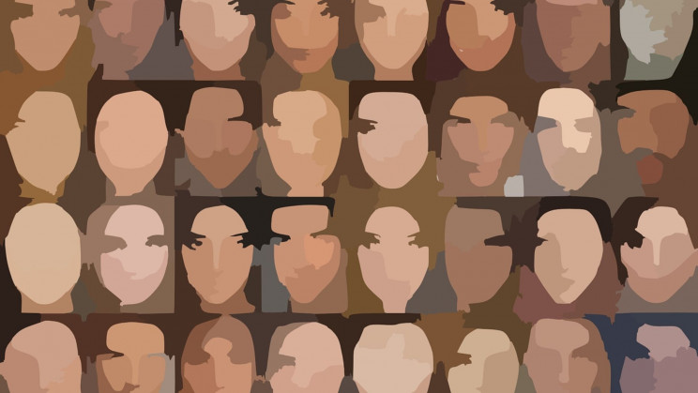
Clker-Free-Vector-Images/Pixabay

Slide 11
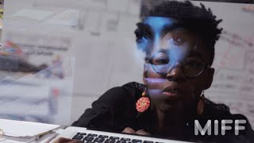
Coded Bias
Notes:
Coded Bias, then ask for any responses in chat or unmute
Backup link: https://www.imdb.com/title/tt11394170/

Slide 12
From Black to White to Technicolor: Debiasing Racism in Computer Vision Computer vision is an ever-growing field in AI, but there's a big problem— it's racist.
Computer vision is a form of AI focused on teaching computers to comprehend and interpret images. … CV is dependent on deep learning, a subfield of machine learning. In order to finely-tune a computer’s “sight”, it needs to be fed data — a lot of data. But there’s an issue with this data: it’s often biased.
It's estimated that some 33 million autonomous vehicles will be on the road by 2040… The problem? The computer vision systems in these vehicles can't recognize pedestrians with darker skin tones.
Among darker-skinned females, accuracy rates were as much as 34% lower than than the rates for lighter-skinned males. In fact, of the faces incorrectly gendered by Microsoft, 93.6% of them were dark-skinned.
The current color scale used in AI, the Fitzpatrick Skin Type, wasn’t even created for identifying skin tone -- it was to classify skin types that were most at risk for sunburn. This system grossly oversimplifies color, categorizing shade into just six groups.
https://interestingengineering.com/from-black-to-white-to-technicolor-debiasing-racism-in-computer-vision
Notes:
https://interestingengineering.com/from-black-to-white-to-technicolor-debiasing-racism-in-computer-vision

Slide 13

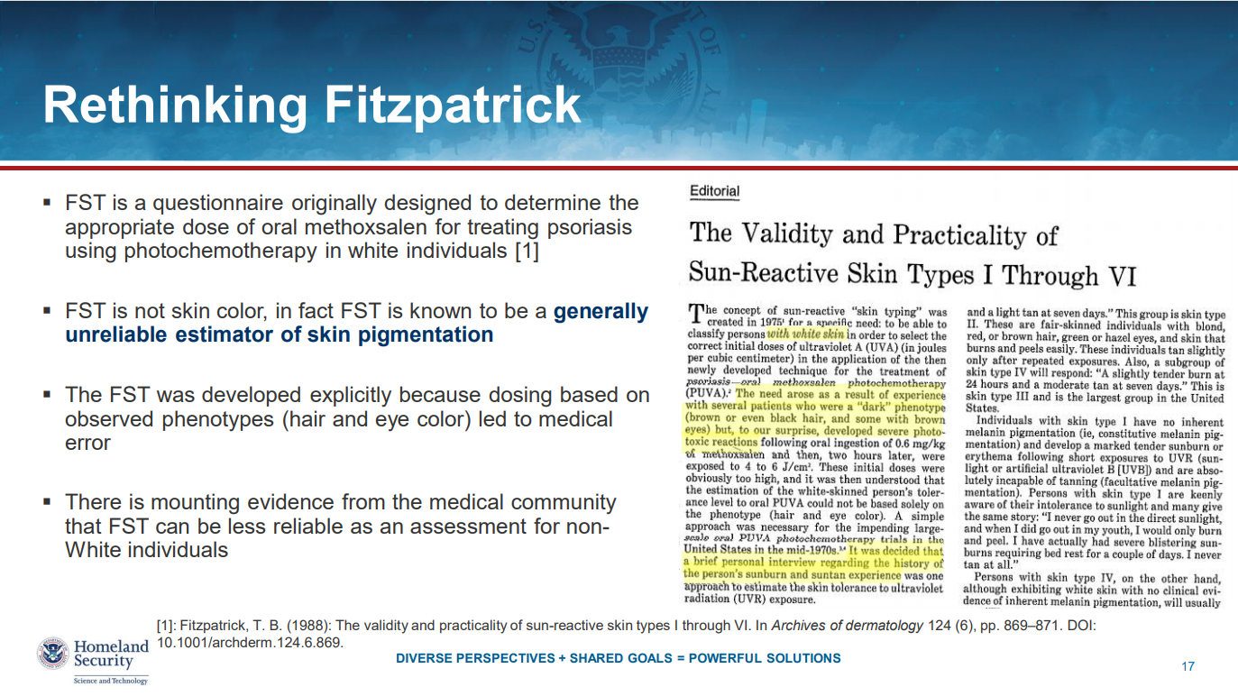
https://pages.nist.gov/ifpc/2020/presentations/36_Fitzpatrick_IFPC2020_Final.pdf
Notes:
https://pages.nist.gov/ifpc/2020/presentations/36_Fitzpatrick_IFPC2020_Final.pdf

Slide 14
The Best Algorithms Struggle to Recognize Black Faces Equally
US government tests find even top-performing facial recognition systems misidentify blacks at rates five to 10 times higher than they do whites.
Test results from the NIST indicated that two of Idemia’s latest algorithms were significantly more likely to mix up black women’s faces than those of white women, or black or white men.
The government reports echo critical 2018 studies from ACLU and MIT researchers openly wary of the technology. They reported algorithms from Amazon, Microsoft, and IBM were less accurate on darker skin.
Some civil liberties advocates, lawmakers, and policy experts want government use of the technology to be restricted or banned, as it was recently in San Francisco and two other cities. Their concerns include privacy risks, the balance of power between citizens and the state—and racial disparities in results.
Buolamwini was a star witness at a May hearing of the House Oversight and Reform Committee, where lawmakers showed bipartisan interest in regulating facial recognition. Elijah Cummings (D-Maryland) said racial disparities in test results heightened his concern at how police had used facial recognition during 2015 protests in Baltimore over the death in police custody of Freddie Gray, a black man. Jim Jordan (R-Ohio): “[If] a facial recognition system makes mistakes and those mistakes disproportionately affect African Americans and persons of color, [it] appears to me to be a direct violation of Americans’ First Amendment and Fourth Amendment liberties,” he said.
https://www.wired.com/story/best-algorithms-struggle-recognize-black-faces-equally
Notes:
https://www.wired.com/story/best-algorithms-struggle-recognize-black-faces-equally

Slide 15
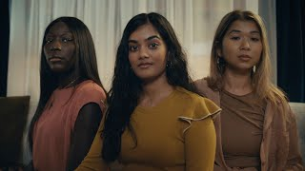
Notes:
https://skintone.google/the-scale

Slide 16
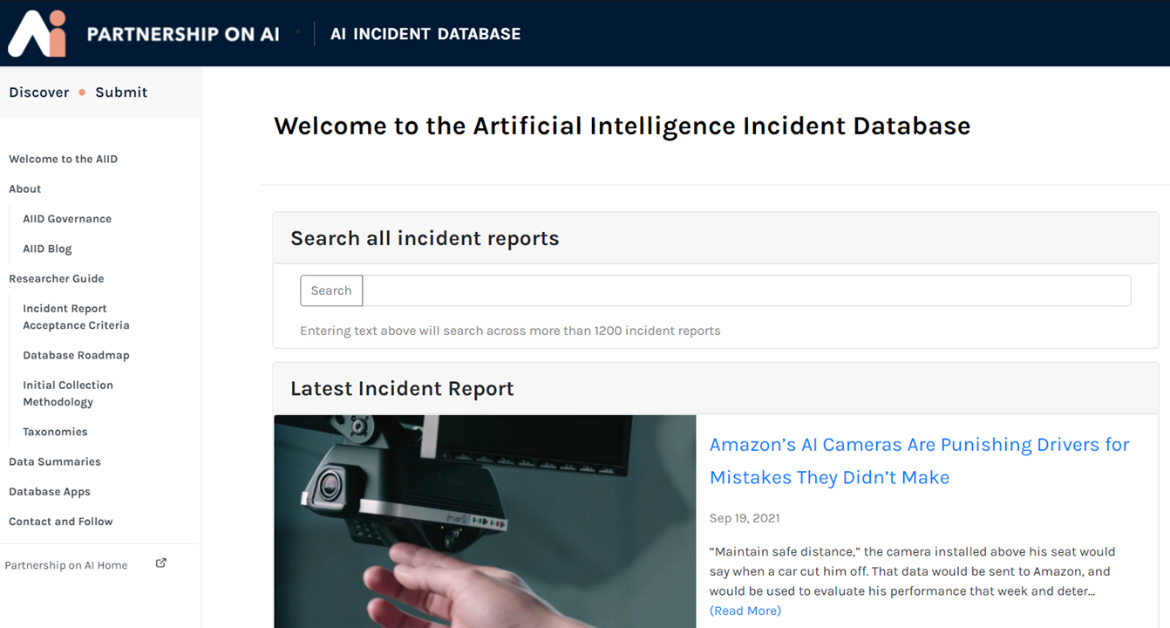
Notes:
https://incidentdatabase.ai/

Slide 17
Favorite Educational Experiences
Think of at least 3 positive moments, experiences, lessons, teachers, etc.
What was powerful or special?
Why or how did that teacher design the experience? If you were a teacher, how might you build on this?

Slide 18
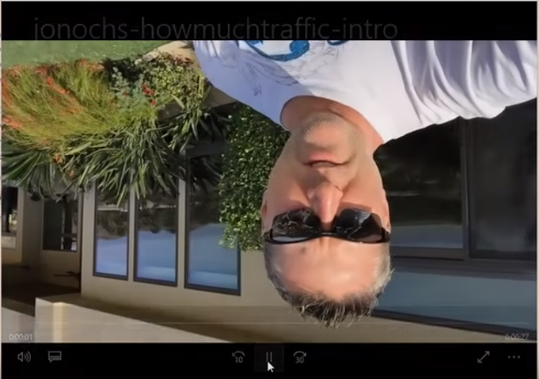
YouTube video upload app for iOS
Source of story: https://googleblog.blogspot.com/2014/09/you-dont-know-what-you-dont-know-how.html
Video Screenshot: https://www.youtube.com/watch?v=Q0zEn96gY_w
Notes:
Here is an example: When YouTube launched their video upload app for iOS, between 5 and 10 percent of videos uploaded by users were upside-down. Were people shooting videos incorrectly? No. The early design was the problem. It was designed for right-handed users, but phones are usually rotated 180 degrees when held in left hands. Without realizing it, YouTube had created an app that worked best for the almost exclusively right-handed developer team.

Slide 19
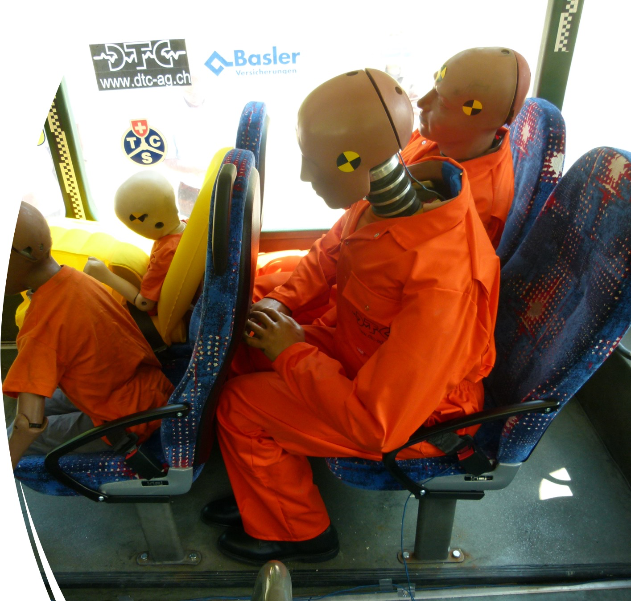
Seatbelt Design
Source of story: https://medium.com/@AnnaJS15/where-are-all-the-female-crash-test-dummies-a1391795be41
Photo: https://www.flickr.com/photos/touring_club/5841916984
Notes:
A 2011 study determined that female seat-belted drivers in actual crashes had a 47% higher chance of injury than male belted drivers in equivalent crashes. This percentage rose to 71% for ‘moderate injuries’. Why might this be? Until 2011, crash ratings were based only off of male crash dummies. It was until 2011 when the first female crash test dummies were required in safety testing.

Slide 20
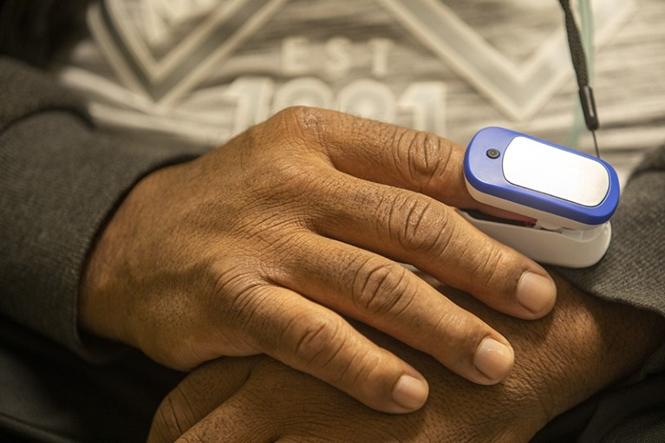
Fingertip oxygen sensors can fail on dark skin
Source of story: https://www.nature.com/articles/d41586-024-00089-6
Photo: Francine Orr/Los Angeles Times via Getty
Notes:
NEWS -18 January 2024
Fingertip oxygen sensors can fail on dark skin — now a physician is suing
A community health canter in California led by the researcher files the first lawsuit against pulse oximeter manufacturers.
A physician in California is pursuing a lawsuit against 12 companies over their continued sale of devices that researchers say inaccurately measure blood-oxygen levels in people of color. Studies^{1,2,3,4} — some decades old — have established that the devices, called pulse oximeters, can overestimate the amount of oxygen in the blood of people with dark skin, which could lead health professionals to delay or decide against treatment.

Slide 21
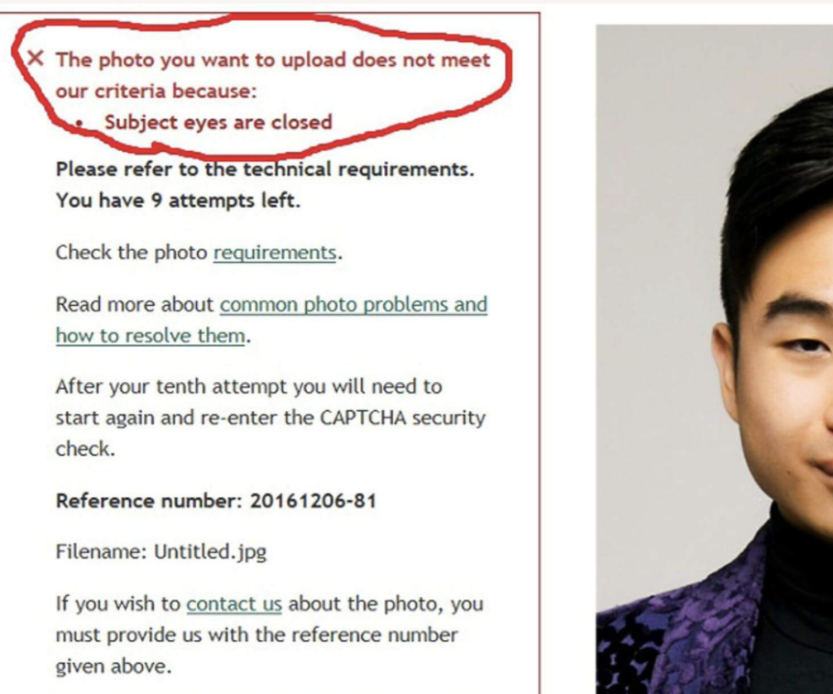
Algorithmic Photo Checker Failed to Detect Open Eyes
Source of story: https://qz.com/857122/an-algorithm-rejected-an-asian-mans-passport-photo-for-having-closed-eyes
Photo: Reuters/Handout from Richard Lee
Notes:
By Selina Cheng
Published December 7, 2016
Earlier this week, an Asian New Zealander posted a screenshot to Facebook showing his passport photo being rejected for having closed eyes, even though they are visibly open. Twenty-two-year-old Richard Lee—an engineer student from New Zealand who was born in Taiwan and is currently studying in Melbourne, Australia—was trying to renew his passport online using an algorithm-based photo-checker operated by New Zealand’s department of internal affairs.
Lee took the mess-up in stride. “No hard feelings on my part,” he told Reuters. “I’ve always had very small eyes and facial recognition technology is relatively new and unsophisticated.” He also toldMashable that he ended up taking more photos, one of which was accepted by the system.

Slide 22
How Inclusive Excellence Support Our Fields?
Inclusive Excellence Can Help To:
Avoid making assumptions
Avoid unconscious biases
Consider others’ perspectives
Create inclusive solutions
Inclusive Design Can Help To:
Increases Accessibility
Improves Safety
Enhances Usability
Sparks Innovation
Promotes Diversity
Notes:
Inclusive Design: The Key to a More Equitable World - https://www.hurix.com/inclusive-design-the-key-to-a-more-equitable-world/ - May 30, 2024
[You can present the four provided examples or choose only some of them or even include an example closer to your own filed or the major of your students. The idea is to present the example and you can spend a couple of minutes discussing with them what are the missing things related to inclusion and diversity that the engineers behind these solutions missed or should include in the design. During the discussion you can emphasize on how the fact that considering diversity helped to create a better product/service as well as how the concept of universal design, when it is well used could be very benefic.]

Slide 23
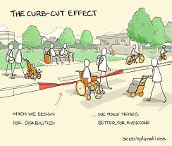
Example of Inclusive Designs
Curb Cuts
Initially for people using wheelchairs
Used by
Parents with strollers
Delivery people with carts
Bikers
Notes:
Inclusive Design: The Key to a More Equitable World - https://www.hurix.com/inclusive-design-the-key-to-a-more-equitable-world/ - May 30, 2024

Slide 24

Example of Inclusive Designs
Automatic Doors
Initial design to assist people with mobility impairments
Used by
People with full hands
Parents with strollers
Elders in carts
Notes:
Inclusive Design: The Key to a More Equitable World - https://www.hurix.com/inclusive-design-the-key-to-a-more-equitable-world/ - May 30, 2024

Slide 25
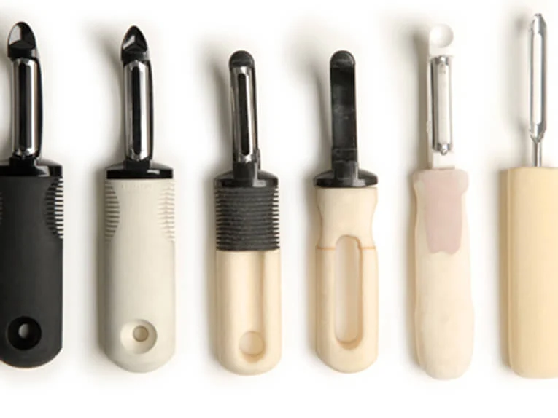
Example of Inclusive Designs
Utensils Design (OXXO)
Designed to aid elders
Used by
anyone
Notes:
Behind the Design: OXO's Iconic Good Grips Handles - https://www.oxo.com/blog/behind-the-scenes/behind-design-oxos-iconic-good-grips-handles - Jan 31, 2017

Slide 26

Example of Inclusive Designs
Netflix (scary good) captions – they provide detail into the ambient sounds and background music.
Originally to aid people with hearing impairment
Now used by
People in noise environments
People learning the language
Notes:
4 Inspiring Inclusive Design Examples for the Web - https://www.audioeye.com/post/4-inspiring-inclusive-design-examples-for-the-web/ - March 18, 2024

Slide 27
Favorite Educational Experiences
Think of at least 3 positive moments, experiences, lessons, teachers, etc.
What was powerful or special?
Why or how did that teacher design the experience? If you were a teacher, how might you build on this?

Slide 28
Engineering &
Engineering Technology
by the Numbers
Data from ASEE 2022 Edition
July 1, 2020, to June 30, 2022
https://ira.asee.org/wp-content/uploads/2024/03/Engineering-and-Engineering-Technology-by-the-Numbers-cover-combined.pdf
Notes:
The reminding of the slides provides information from the American Society for Engineering Education about the number of engineering students in diverse levels and provides information related to how they include underrepresented minorities, and gender.
If the time allows you, you can show all of some of this information and talk about diversity at ASU particularly in the engineering programs.
It is important to highlight that even when the numbers are “good” in some cases, it is because ASU’s scale.
It is important to emphasize that when there are efforts to make our community diverse, there is still work to do and we are in part responsible of it.
Diversity and inclusion do not only mean to have representation but to have programs and resources to serve this diversity and inclusion.

Slide 29
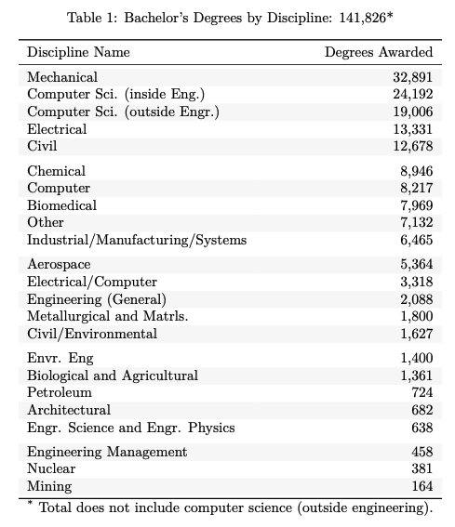
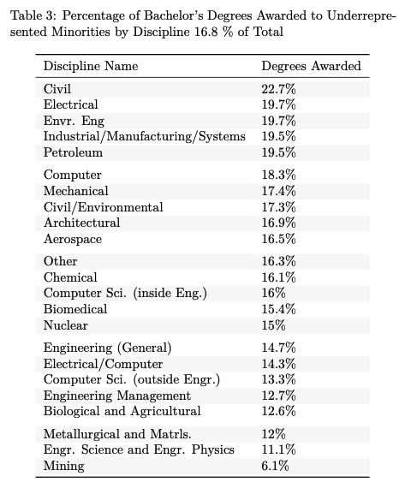
Bachelor’s Degrees
Notes:
Underrepresented minority: ASEE uses the definition from prior editions of NSF’s Science and Engineering Indicators report (https://ncses.nsf.gov/pubs/nsb20201/glossary): "this category comprises three racial or ethnic minority groups (blacks or African Americans, Hispanics or Latinos, and American Indians or Alaska Natives) whose representation in S&E education or occupations is smaller than their representation in the U.S. population."

Slide 30
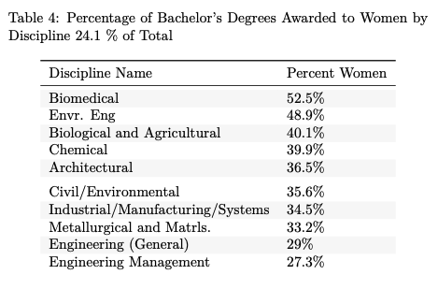
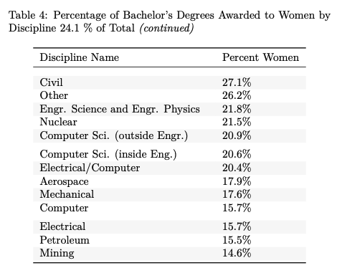
Bachelor’s Degrees

Slide 31
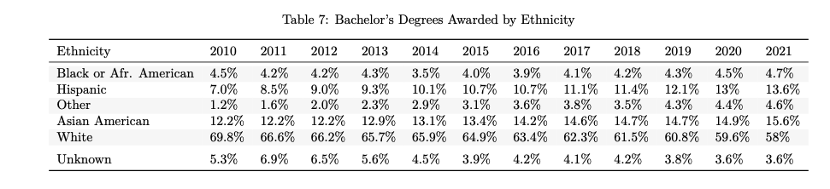
Bachelor’s Degrees

Slide 32
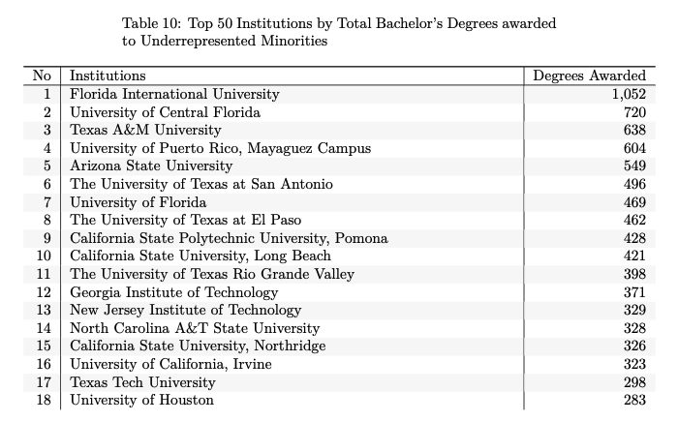
Bachelor’s Degrees
Notes:
Underrepresented minority: ASEE uses the definition from prior editions of NSF’s Science and Engineering Indicators report (https://ncses.nsf.gov/pubs/nsb20201/glossary): "this category comprises three racial or ethnic minority groups (blacks or African Americans, Hispanics or Latinos, and American Indians or Alaska Natives) whose representation in S&E education or occupations is smaller than their representation in the U.S. population."

Slide 33
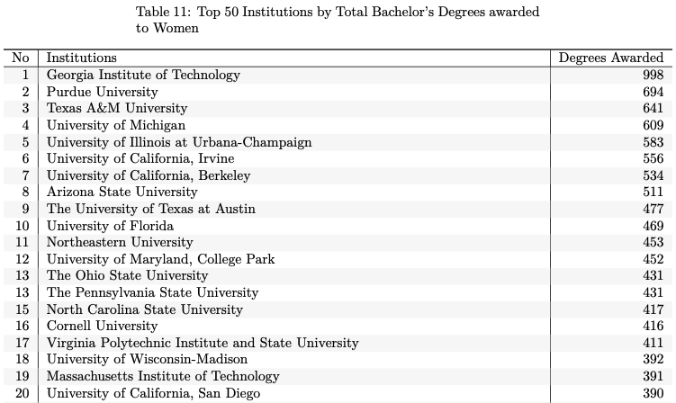
Bachelor’s Degrees
Notes:
Underrepresented minority: ASEE uses the definition from prior editions of NSF’s Science and Engineering Indicators report (https://ncses.nsf.gov/pubs/nsb20201/glossary): "this category comprises three racial or ethnic minority groups (blacks or African Americans, Hispanics or Latinos, and American Indians or Alaska Natives) whose representation in S&E education or occupations is smaller than their representation in the U.S. population."

Slide 34
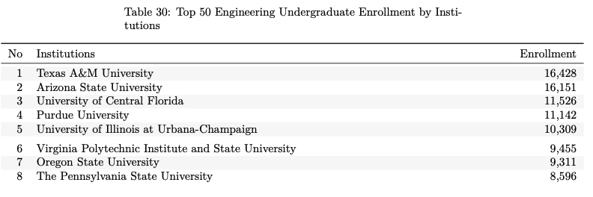
Bachelor’s Degrees (Fall 2022)

Slide 35
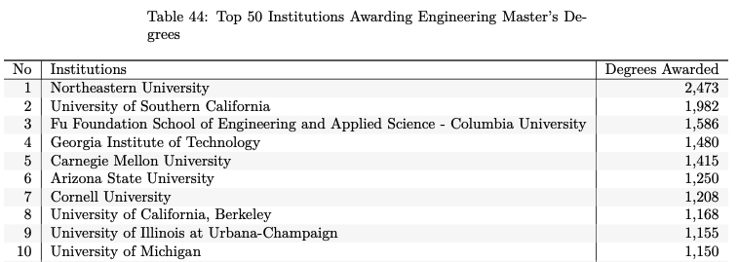
Master’s Degrees

Slide 36
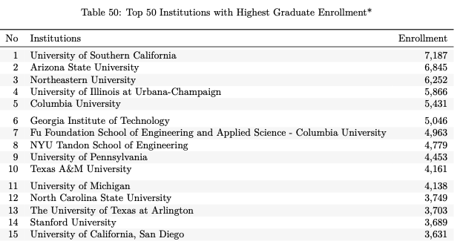
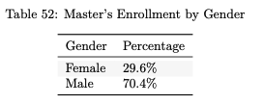
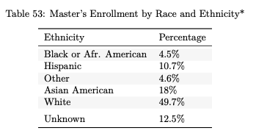
Master’s Degrees

Slide 37
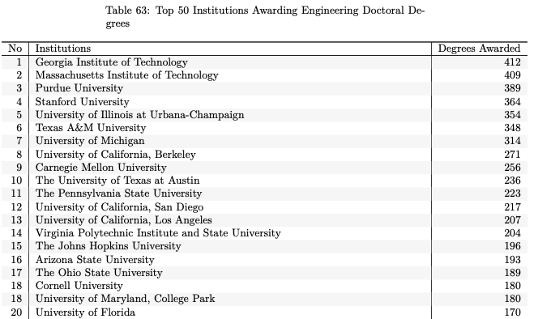
Doctoral Degrees

Slide 38
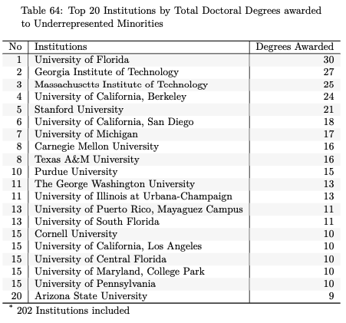
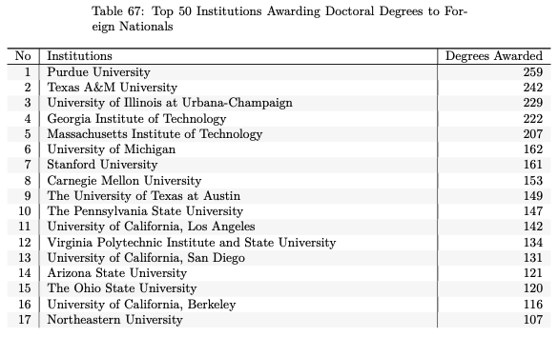
Doctoral Degrees

Slide 39
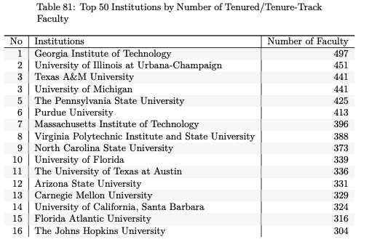
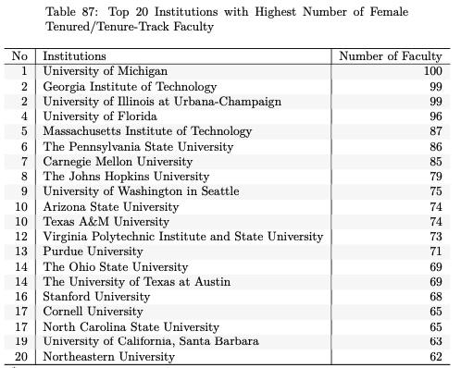
Tenure/Tenure-Track Engineering Faculty

Slide 40
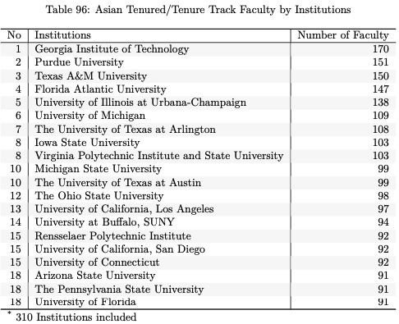
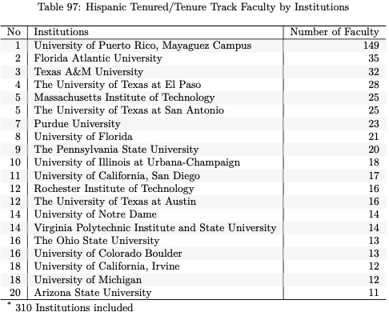
Tenure/Tenure-Track Engineering Faculty

